Slide 1

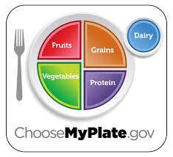
Nutrition
http://www.choosemyplate.gov/food-groups/

Slide 2

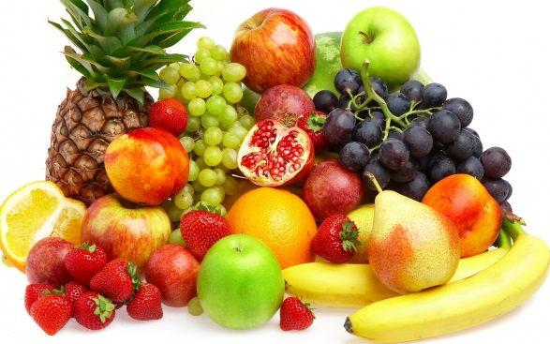
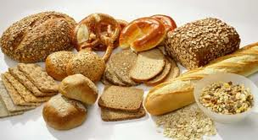
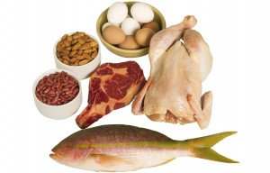
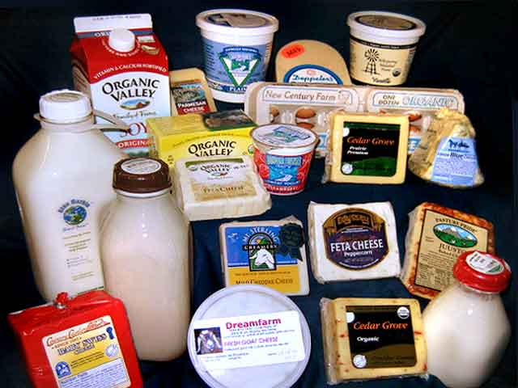
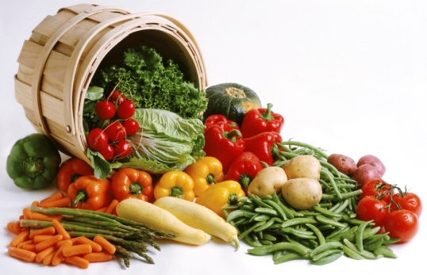
FOOD GROUPS
FRUITS
GRAINS
VEGETABLES
DAIRY
PROTEIN

Slide 3


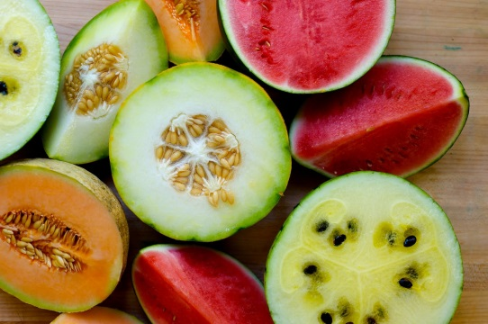
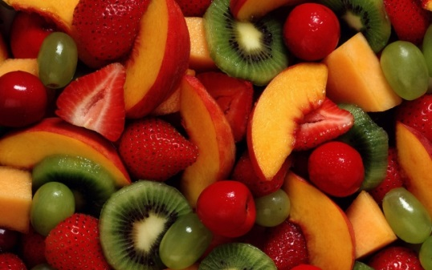
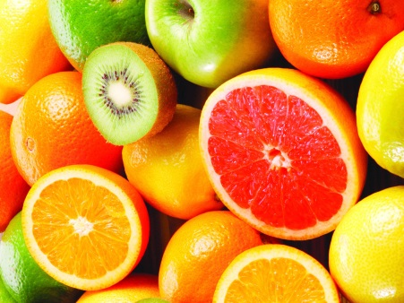
Fruits
Commonly Eaten Fruits
Berries
Strawberries
Blackberries
Blueberries
Raspberries
Melons
Cantaloupe
Honeydew
Watermelon
Apples
Apricots
Bananas
Cherries
Grapefruit
Grapes
Kiwi
Lemons
Limes
Mangoes
Nectarines
Oranges
Peaches
Pears
Papaya
Pineapple
Plums
Prunes
Raisins
Tangerines

Slide 4

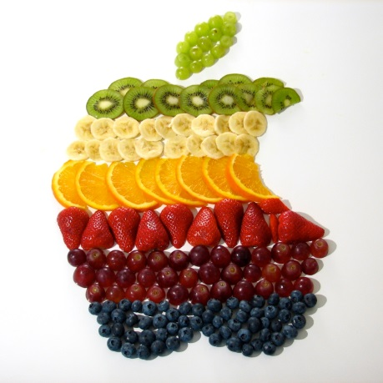
Why Fruit
Benefits
Most fruits are naturally low in fat, sodium, and calories. None have cholesterol
Vitamin C is important for growth and repair of all body tissues, helps heal cuts and wounds, and keeps teeth and gums healthy.
Eating foods such as fruits that are lower in calories per cup instead of some other higher-calorie food may be useful in helping to lower calorie intake.
Berries improve both your eyesight , memory, and long-term brain functioning.
How Much
1.5 – 2 cups per day
*See what one cup looks like:

Slide 5

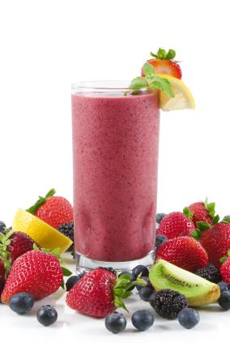


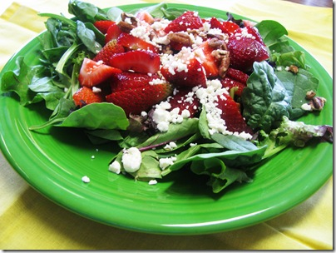
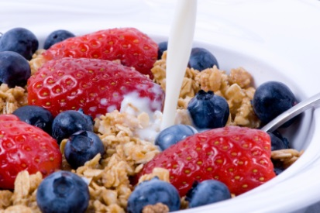


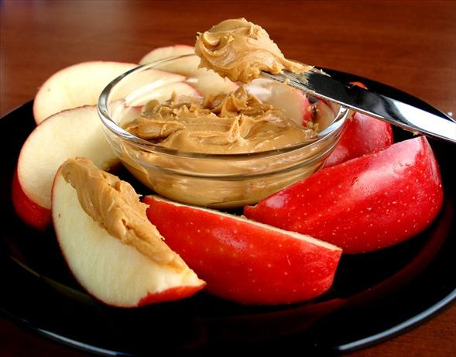

Healthy Suggestions
Fruit cocktail / Fruit Salad
Frozen fruit smoothie (mix in yogurt and water)
Fruit on your cereal or oatmeal
Flavor your water
Berries and milk (eaten like cereal)
Yogurt parfait
As a salad topping (strawberry fields salad)
On top of cottage cheese
On top of Fresh Toast, waffles, pancakes
Apples or bananas with peanut butter

Slide 6

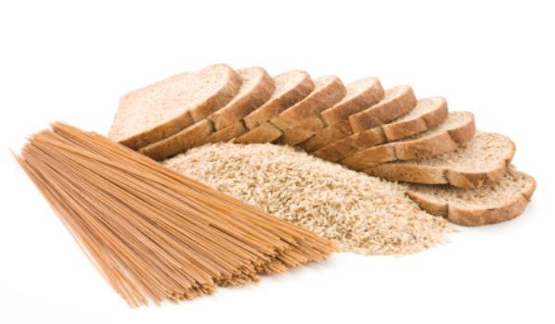
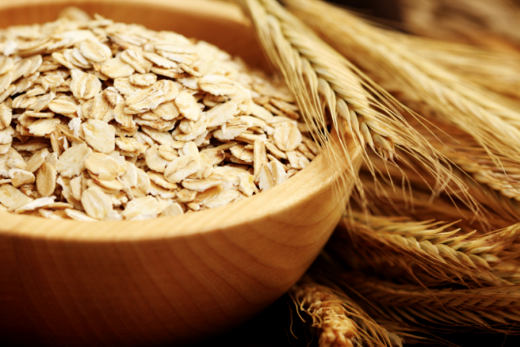
GRAINS
Whole Grains
Refined
Cornbread
Corn Tortillas
Couscous
Crackers
Flour Tortillas
Grits
Noodles
Spaghetti
Grains
-Pitas
-Pretzels
-White Bread
-White Rice
-White
Sandwich
buns &rolls
-Macaroni
Brown Rice
Buckwheat
Oatmeal
Popcorn
Quinoa
Whole Grain Barley
Whole Rye
-Whole Wheat Bread
-Whole Wheat Crackers
-Whole Wheat Pasta
-Whole Wheat Tortillas
-Wild Rice
-Whole Wheat Sandwich
Rolls & Buns
-Whole Wheat Cereal
Limit These

Slide 7

Why Whole Grains
Benefits
Consuming whole grains as part of a healthy diet may reduce the risk of heart disease.
Consuming foods containing fiber, such as whole grains, as part of a healthy diet, may reduce constipation.
Eating whole grains may help with weight management.
Grains are important sources of many nutrients, including dietary fiberGrains are important sources of many nutrients, including dietary fiber, several B vitamins (thiamin, riboflavin, niacin, and folate), and minerals (ironGrains are important sources of many nutrients, including dietary fiber, several B vitamins (thiamin, riboflavin, niacin, and folate), and minerals (iron, magnesium, and selenium).
How Much
Men: 18-30 years old:
4-8 oz. per day
- Women 18-30 years old:
3-6 oz per day
*See what 3-8 ounces looks like:

Slide 8

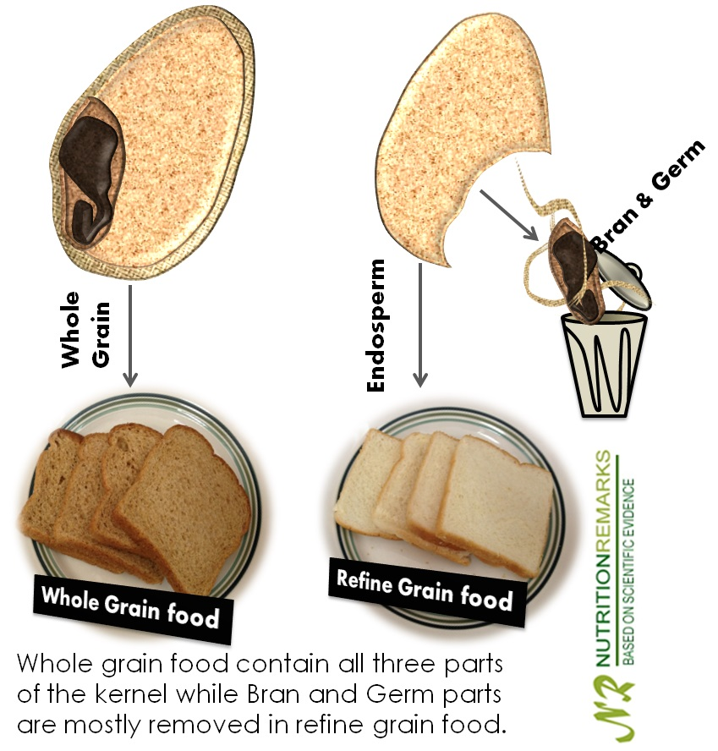
Whole Grain vs. Processed

Slide 9
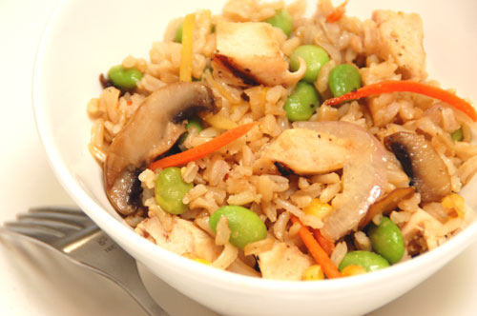

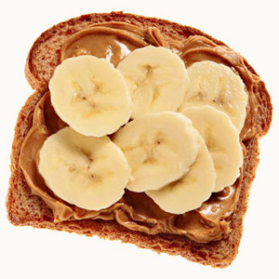

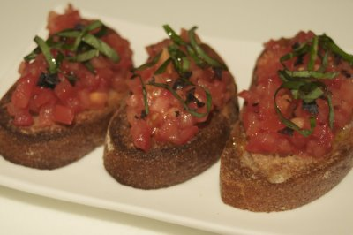
Healthy Suggestions
Whole grain toast with peanut butter & banana.
Mix in whole grain rice with vegetables and protein for a stir fry.
Create your own pizza on a whole wheat pita or English muffin.
Whole wheat quesadillas.
Whole wheat crackers with bruschetta.

Slide 10

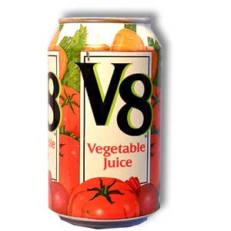
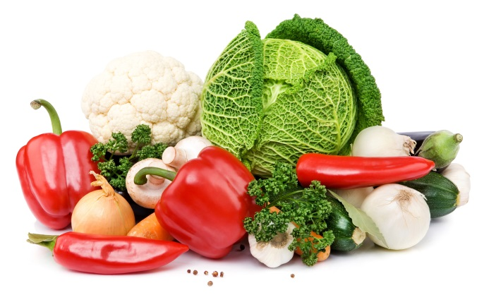
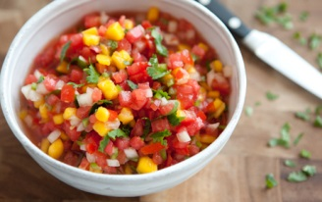
Vegetables
Dark Green
Red & Oranges
Butternut Squash
Carrots
Pumpkin
Red Peppers
Sweet Potatoes
Tomatoes
Tomato Juice
Beans
& Peas
Black Beans
Garbanzo Beans
Kidney Beans
Lentils
Navy Beans
Pinto Beans
Soy Beans
Split Peas
Other Veggies
Artichokes
Asparagus
Avocado
Beets
Brussels Sprouts
Cabbage
Cauliflower
Celery
Cucumbers
Eggplant
Green Beans
Green Peppers
Mushrooms
Onions
Zucchini
Starchy
Broccoli
Collard Greens
Dark Lettuce
Kale
Romaine Lettuce
Spinach
Turnip Greens
Watercress
Corn
Black Eyed Peas
Green Bananas
Green Peas
Green Lima Beans
Plantains
Potatoes
Water Chestnuts

Slide 11
Why Vegetables
Benefits
Eating a diet rich in vegetables and fruits as part of an overall healthy diet may reduce risk for heart disease, including heart attack and stroke and may protect against certain types of cancers.
Diets rich in foods containing fiber, such as some vegetables and fruits, may reduce the risk of heart disease, obesity, and type 2 diabetes.
Vegetables are important sources of many nutrients, including potassium, dietary fiber, folate (folic acid), vitamin A, and vitamin C.
Vitamin A keeps eyes and skin healthy and helps to protect against infections.
How Much
Men: (14-30 years old)
3 cups per day
- Women (14-30 years old)
2.5 cups per day
*See what 2.5 - 3 cups looks like:

Slide 12
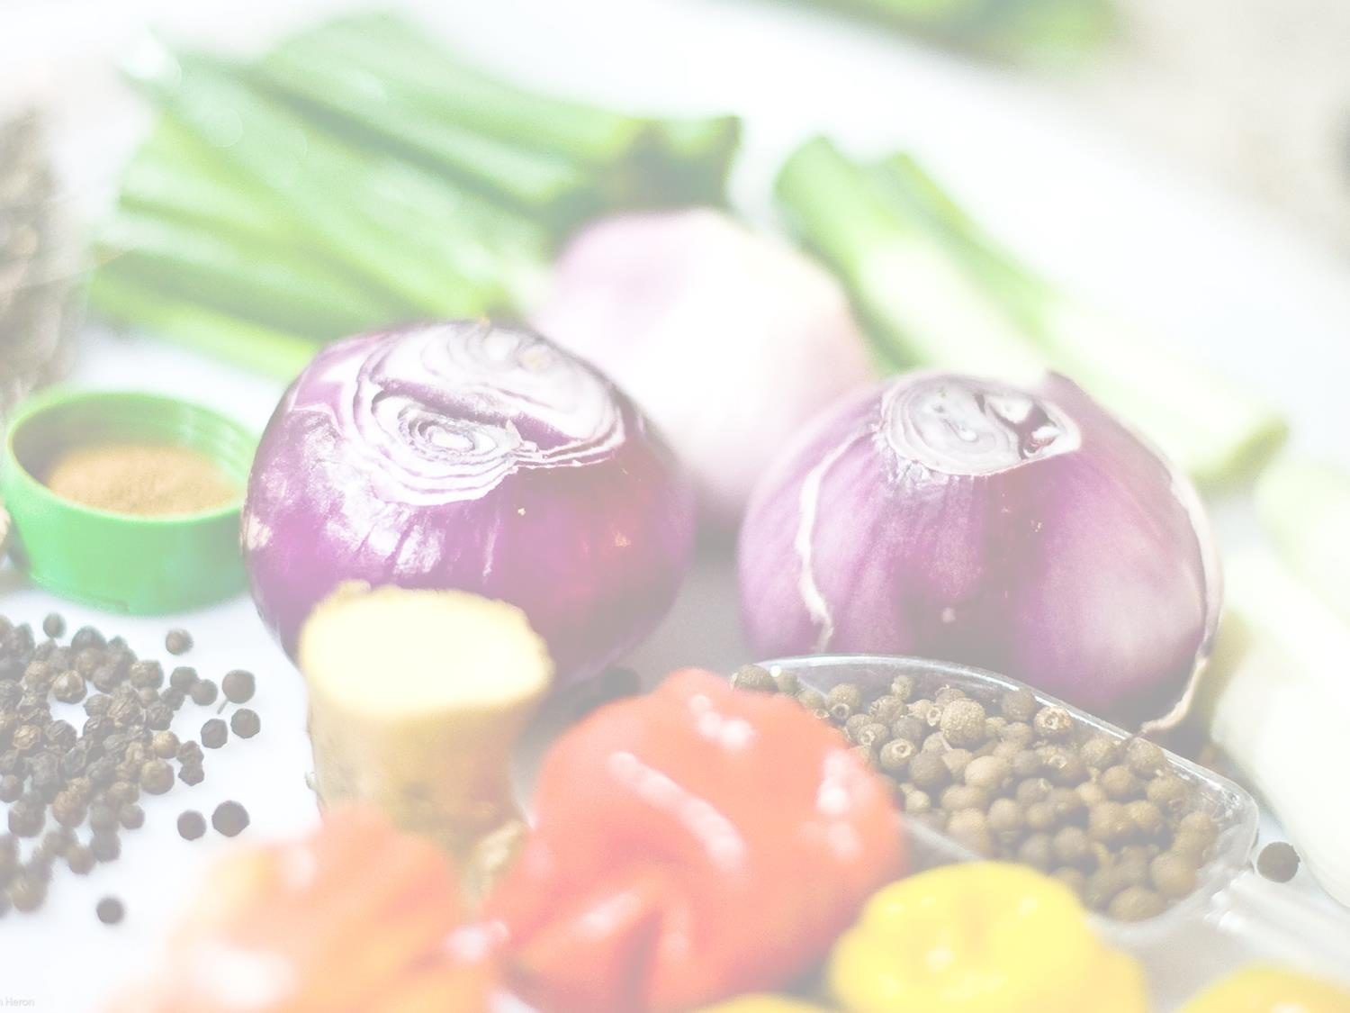



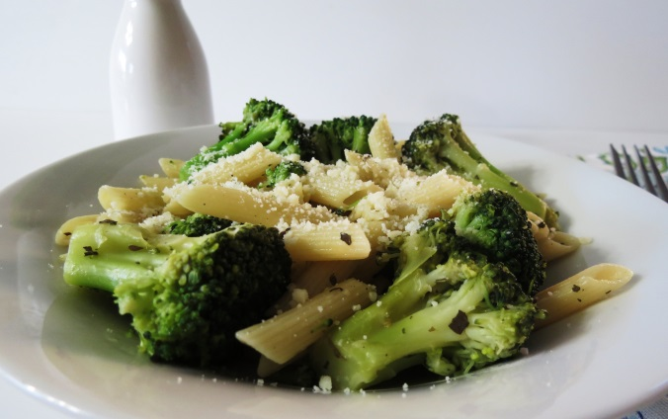
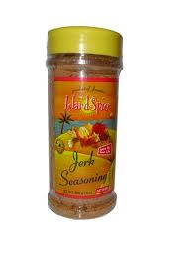
Healthy Suggestions
Veggies and dip (yogurt, hummus, or guacamole)
Use salsa as a condiment (on sandwiches, eggs, chicken, pork, etc.)
Grilled zucchini with drizzled olive oil and spices
Broccoli with melted cheese over top.

Slide 13

Dairy
Milk
Milk-Based Deserts
Cheese
Hard Natural
-Cheddar
-Mozzarella
-Swiss
-Parmesan
Soft Cheeses
-Ricotta
-Cottage Cheese
Processed:
-American
Yogurt
Fat Free
Low Fat
Reduced Fat
Whole Milk Yogurt
Fat Free (Skim)
Low Fat (1%)
Reduced Fat (2%)
Whole Milk
Flavored Milks:
-Chocolate
-Strawberry
Lactose-Free Milk
Puddings
Ice Milk
Frozen Yogurt
Ice Cream

Slide 14

Why Dairy
Benefits
Intake of dairy products is linked to improved bone health, and may reduce the risk of osteoporosis.
Intake of dairy products is also associated with a reduced risk of cardiovascular disease and type 2 diabetes, and with lower blood pressure in adults.
Vitamin D functions in the body to maintain proper levels of calcium and phosphorous, thereby helping to build and maintain bones.
How Much
Men: (14-30 years old)
3 cups per day
- Women (14-30 years old)
3 cups per day
*See what 3 cups looks like:

Slide 15



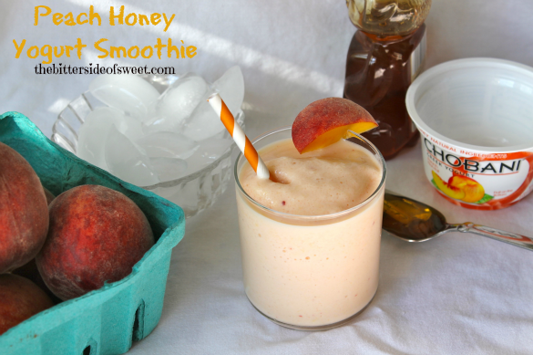


Healthy Suggestions
Make a dip using yogurt (for fruit or vegetables).
Using low fat or fat free milk, make chocolate or butterscotch pudding.
Fruit-yogurt smoothies
Top a baked potato with low fat yogurt
Sprinkle low fat cheese on top of soup, salad, eggs, or other food items.

Slide 16
Protein
Meats
Poultry &
Eggs
Nuts & Seeds
Almonds
Cashews
Hazelnuts
Peanuts
Peanut Butter
Pecans
Pistachios
Pumpkin Seeds
Sesame Seeds
Sunflower Seeds
Walnuts
Seafood
Cod
Flounder
Salmon
Sea Bass
Snapper
Swordfish
Trout
Tuna
Clams
Crab
Lobster
Mussels
Octopus
Scallops
Shrimp
Beans & Peas, Soy
Bean Burgers
Black Beans
Chickpeas
Kidney Beans
Lentils
Lima Beans
Pinto Beans
Soy Beans
Split Peas
Lean Cuts of:
-Beef
-Ham
-Lamb
-Pork
-Veal
Game Meats
-Bison
-Venison
-Chicken
-Duck
-Goose
-Turkey
-Ground Chicken
-Ground Turkey
-Chicken Eggs
-Duck Eggs

Slide 17
Why Protein
Benefits
Proteins function as building blocks for bones, muscles, cartilage, skin, and blood. They are also building blocks for enzymes, hormones, and vitamins. Proteins are one of three nutrients that provide calories (the others are fat and carbohydrates).
B vitamins found in this food group serve a variety of functions in the body. They help the body release energy, play a vital role in the function of the nervous system, aid in the formation of red blood cells, and help build tissues.
EPA and DHA are omega-3 fatty acids found in varying amounts in seafood. Eating 8 ounces per week of seafood may help reduce the risk for heart disease.
How Much
Men: (14-30 years old)
6.5 oz. per day
- Women (14-30 years old)
5-5.5 oz. per day
*See what 5.5-6.5 oz. looks like:

Slide 18
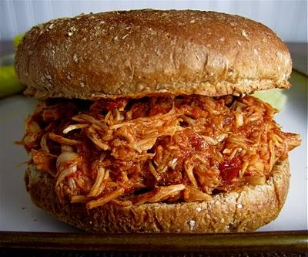

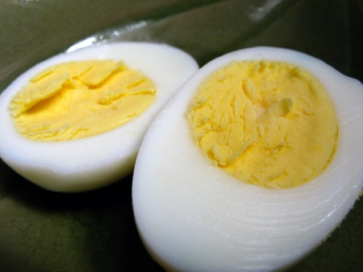
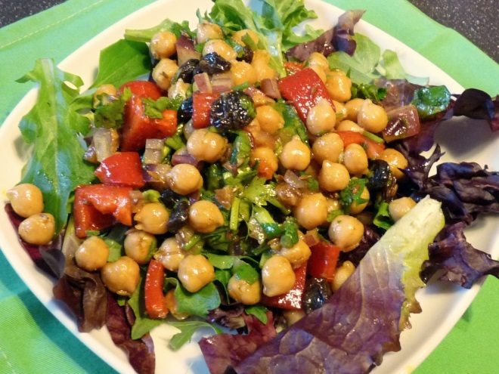
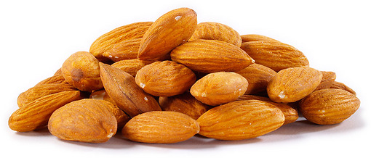
Suggestions
Pulled chicken-breast sandwiches (chicken breast, salsa, E-V Olive Oil, and spices in the crock pot)
Turkey breast wrap
Eggs (hard boiled, egg & cheese muffin, and many other options)
Chick peas in your salad
Peanut butter with fruit (bananas or apple)
Raw almonds in a snack baggy

Slide 19
Snacks
http://kidshealth.org/PageManager.jsp?dn=KidsHealth&lic=1&ps=207&cat_id=20132&article_set=20393
TIPS:
Save time by slicing up veggies in advance
Grab a glass of milk for a snack – either low-fat or fat-free.
Go for whole grains – either bread, toast, mini-bagel, or English muffin. Just try to make it whole wheat.
Nibble on Lean Protein – Choose deli meats, unsalted nuts, or eggs to snack on.
Keep an eye on the size – Remember, snacks should not be an extra meal. It should just hold you over until your next meal.
Fruits are quick and easy!
Consider convenience – Single serving containers such as low-fat yogurt or individually wrapped string cheese can be a great after school snack.

Slide 20

“Eat This… Not That”
…The Game
Visit the website:
http://www.slideshare.net/bethecatalyst/eat-this-not-that
Select either Breakfast, Lunch, Dinner, or Dessert.

Slide 21

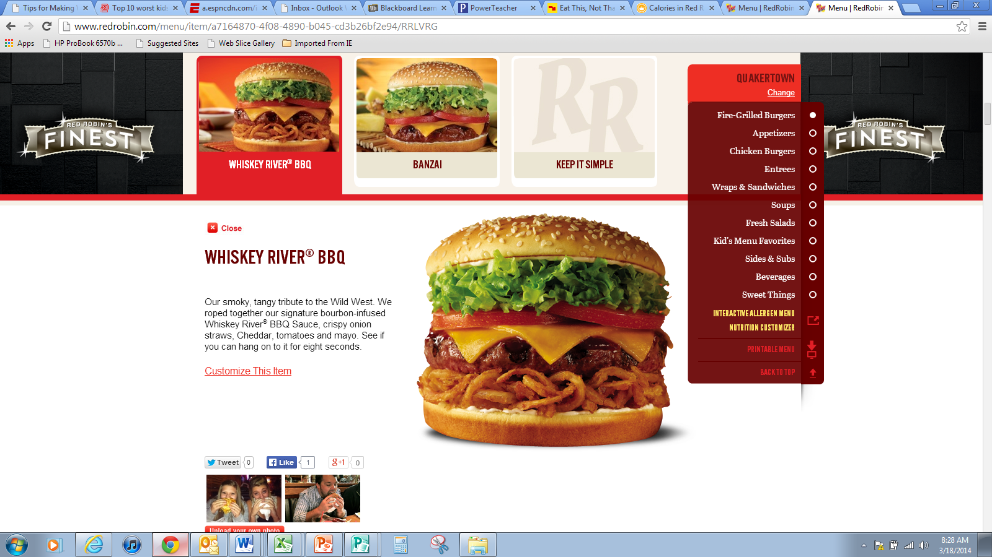
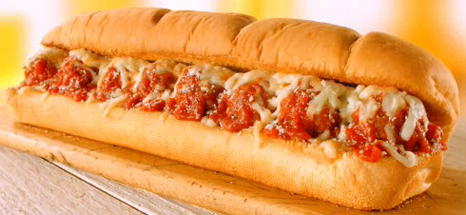
Create Your Own: Eat This… Not That
- Group of 2-4 people
-2 Examples/Comparisons on Power Point Slides (Have nutrition facts ready to share)
- Be ready to share with class on Thurs. (use CalorieKing.com as reference)
Red Robin Whisky River Burger
Subway Meatball Marinara

Slide 22


Nutrition Facts
Calories 1408 | (5885 kJ)
Calories from fat 801
% Daily Value 1
Total Fat | 89g | 137%
Sodium | 1717mg | 72%
Total Carbs. | 98g | 33%
Dietary Fiber | 6g | 24%
Sugars | 21g
Protein | 47g
Red Robin Whisky River Burger
Subway Meatball Marinara

Slide 23


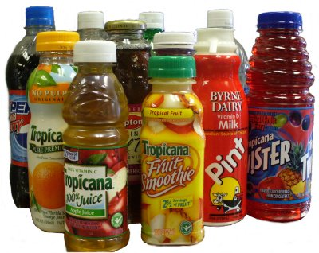
Drinks
Water
Everything Else
A perfect drink that contains zero calories and no additives.
65% of your body is made of water.
Drinking water helps regulate body temperature, cushions internal organs, lubricates joints, and is the most important substance you put into your body.
Try drinking water with your meals and whenever you feel thirsty!
FACT: Tap water is every bit as beneficial as bottled/filtered water.
Sodas
Diet Sodas
Sports Drinks
Fruit Juices
Coffee and Tea
Alcohol
FACT
Most Americans consume 22% of their daily calories through their drinks

Slide 24




Sugary Drinks
SODA
Provides ZERO nutritional value with great health risks.
In kids, a single serving of soda daily increases risk of obesity by 60%.
One cup of soda per day can irreversibly damage your tooth enamel.
Adults who consume 2+ sodas per week are 87% more likely to develop pancreatic cancer (one of the most lethal forms).
Drinking 2+ sodas per day DOUBLE your risk of chronic kidney disease.
Stay Away from Soda!
DIET SODA
Consuming 1+ diet soda per day increases changes of heart disease by 50-60%.
Phosphoric acid is one of the main ingredients in diet soda. High levels of phosphoric acid irritates your kidney.
Artificial sweeteners trigger your appetite, making you feel hungry even when you may not actually be hungry.
SPORTS DRINKS
Often taken to replenish electrolytes during intense exercise sessions.
Unless you are exercising for 40+ minutes, replenishing electrolytes is not overly important.
Water will both rehydrate you and regulate your body temperature during exercise.
Sports drinks load up both sugar and calories.

Slide 25


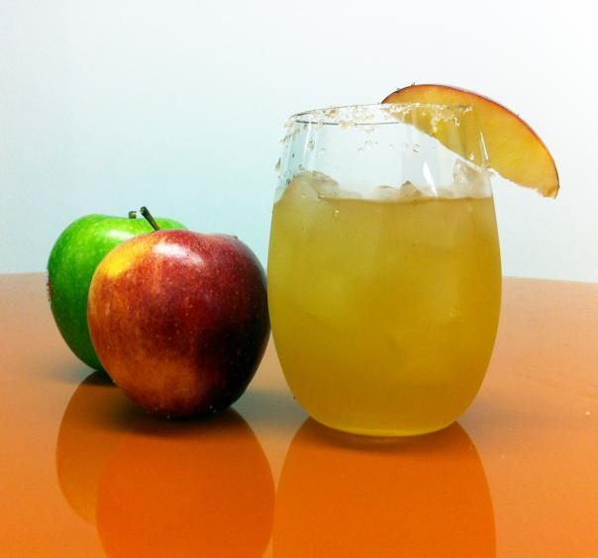

Better Options…
In moderation
FRUIT JUICES
100% fruit juices can provide nutritional value, but they also pack on sugar and calories.
If you NEED to drink your juices, try to limit yourself to no more than 4 oz. of fruit juice a day and select types that are cloudy and have sediment at the bottom.
Fruit juices provide more sugar (fructose) than their solid counterpart. One cup of orange juice provides the sugar make-up 3+ oranges without any of the beneficial fiber.
It is always better to eat your fruit as opposed to drinking it!
COFFEE
Antioxidants found in coffee have proven to actually benefit a drinker’s health.
Evidence has shown that coffee decreases one’s risk of Parkinson’s Disease, Diabetes, Gallstones, Stroke, Alzheimer’s Disease, and suicide.
Caffeine in coffee improves mental performance, lifts mood, and enhances endurance.
Downside to caffeine is that it can interfere with sleep and cause nervousness or jittery feelings. So listen to what your body tells you and don’t over-do it with caffeine.
TEA
Freshly brewed tea can decrease your cardiovascular risk, boost immunity, slow cognitive decline, kick up your metabolism, help reduce stress, and reduce your risk of cancer… all for ZERO calories! *Avoid adding milk or cream

Slide 26



ALCOHOL…
“In Moderation” means: 1 or less drink (women)
2 or less drinks (men)
Latest research shows that drinking in moderation can lower risk of heart disease and strokes by 30%.
Dangers occur when one exceeds moderation and enters into high levels of consumption.
Drinking excessive alcohol increases risk of many cancers, damage to the brain, liver and heart, increases blood pressure, incites bleeding strokes, and leads to addiction and accidents.
Many types of alcohol are high in calories, thus the “beer gut.”
The decision to drink in moderation or not drink should be individualized and should consider your personal and family medical history.
Should always be drank in moderation
(When you are of legal age, of course!)
Because it is fermented using grapes and their skins, red wine is very high in an antioxidant called polyphenols. This makes red wine far and away the “healthiest” type of alcohol.

